Slide 1

Study of algorithm- 4 areas

Slide 2

Study of algorithm
4 areas

Slide 3
How to devise an algorithm:
Creating an algorithm →art
not fully automated,
Using some algorithm design strategies like Divide and Conquer, Greedy & Dynamic programming, - can devise an algorithm.

Slide 4
2.How to validate an algorithm:
Once an algorithm is devised, need to show it computes the correct answer for all possible legal inputs.
We refer to this process as algorithm validation.

Slide 5
3. how to analyze algorithms :
called analysis of algorithm.
Analysis of algorithms or performance analysis refers to the task of determining how much computing time and storage an algorithm requires.

Slide 6
4.How to test a program
Testing a program consists - two phases
debugging and profiling (or performance measurement).
Debugging - process of executing programs on sample data sets to determine faulty result occur and, if so, to correct them
Profiling or performance measurement -executing a correct program on data set and measuring the time and space it takes to compute the results.

Slide 7
Algorithm Analysis…

Slide 8
We only analyze correct algorithms
An algorithm is correct
If, for every input instance, it halts with the correct output
Incorrect algorithms
Might not halt at all on some input instances
Might halt with other than the desired answer
Algorithm Analysis…

Slide 9
Predicting the resources that the algorithm requires
Resources include
Memory
Computational time (usually most important)
Analyzing an algorithm

Slide 10

Factors affecting the running(computational) time
computer
compiler
algorithm used

Slide 11
Algorithm Analysis- important points
input to the algorithm
the input size affects the running time
(number of items in the input) is the main consideration
E.g. sorting problem ⇒ the number of items to be sorted
E.g. multiply two matrices together ⇒ the total number of elements in the two matrices
Machine model assumed
Instructions are executed one after another, with no concurrent operations ⇒ Not parallel computers

Slide 12
Input Size
Input size (number of elements in the input)
size of an array
polynomial degree
# of elements in a matrix
# of bits in the binary representation of the input
vertices and edges in a graph

Slide 13
Apriori and Apostiari Analysis

Slide 14
Apriori Analysis
Apriori analysis analysis means, analysis is performed prior to running it on a specific system.
This analysis is a stage where a function is defined using some theoretical model.
we determine the time and space complexity of an algorithm by just looking at the algorithm rather than running it on a particular system with a different memory, processor, and compiler.

Slide 15
Apostiari analysis
perform analysis of an algorithm only after running it on a system.
It directly depends on the system and changes from system to system.

Slide 16
Apostiari analysis cont…..
In an industry, we cannot perform Apostiari analysis as the software is generally made for an anonymous user, which runs it on a system different from those present in the industry.
In Apriori, it is the reason that we use asymptotic notations to determine time and space complexity as they change from computer to computer; however, asymptotically they are the same.

Slide 17
Analysis of Algorithms- goal
To compare algorithms mainly in terms of running time but also in terms of other factors (e.g., memory requirements, programmer's effort etc.)

Slide 18

Algorithm Analysis…what it means??

Slide 19
Algorithm Analysis…what it means??
there are more than one way to solve a problem.
how to compare the performance different algorithms
Choose the best one to solve a particular problem
mostly consider time complexity and space complexity.

Slide 20

Which is best for problem- how to judge?
2 criteria
Time complexity
Space complexity

Slide 21
Time Complexity
amount of CPU time -to run to completion.
quantifies as a function of the length of the input.
depends on hardware, operating system, processors,
We will only consider the execution time of an algorithm.

Slide 22
Space Complexity
amount of memory -to run to completion.
quantifies as a function of the length of the input.

Slide 23


Time Complexity

Slide 24
Time Complexity
Time required T(P) to run a program P also consists of two components:
A fixed part: compile time which is independent of the problem instance → c.
A variable part: run time which depends on the problem instance → t_{p}(instance)
T(P) = c + t_{p}(instance)

Slide 25
Time Complexity
How to measure T(P)?
Measure experimentally, using a “stop watch”
→ T(P) obtained in secs, msecs.
Count program steps → T(P) obtained as a step count.
Fixed part is usually ignored; only the variable part t_{p}() is measured.

Slide 26
Time Complexity
What is a program step?
a+b+b*c+(a+b)/(a-b) → one step;
comments → zero steps;
while (<expr>) do → step count equal to the number of times <expr> is executed.
for i=<expr> to <expr1> do → step count equal to number of times <expr1> is checked.

Slide 27
Time Complexity: Example 1
 | Statements | S/E | Freq. | Total
1 | Algorithm Sum(a[],n) | 0 | - | 0
2 | { | 0 | - | 0
3 | S = 0.0; | 1 | 1 | 1
4 | for i=1 to n do | 1 | n+1 | n+1
5 | s = s+a[i]; | 1 | n | n
6 | return s; | 1 | 1 | 1
7 | } | 0 | - | 0
2n+3

Slide 28
Example 2
Algorithm Sum(a[],n,m)
{
for i=1 to n do;
for j=1 to m do
s = s+a[i][j];
return s;
}

Slide 29
Time Complexity: Example 2
 | Statements | S/E | Freq. | Total
1 | Algorithm Sum(a[],n,m) | 0 | - | 0
2 | { | 0 | - | 0
3 | for i=1 to n do; | 1 | n+1 | n+1
4 | for j=1 to m do | 1 | n(m+1) | n(m+1)
5 | s = s+a[i][j]; | 1 | nm | nm
6 | return s; | 1 | 1 | 1
7 | } | 0 | - | 0
2nm+2n+2

Slide 30

Space Complexity

Slide 31

Space Complexity
Space complexity is the total amount of memory space used by an algorithm/program including the space of input values for execution.
So to find space-complexity, it is enough to calculate the space occupied by the variables used in an algorithm/program

Slide 32

Why do you need to calculate space complexity?
Similar to Time Complexity, Space-complexity also plays a crucial role in determining the efficiency of an algorithm/program.
If an algorithm takes up a lot of time, you can still wait, run/execute it to get the desired output.
But, if a program takes up a lot of memory space, the compiler will not let you run it.

Slide 33
Space Complexity
Memory space S(P) needed by a program P, consists of two components:
A fixed part:
needed for instruction space (byte code), simple variable space, constants space etc. → c
A variable part:
dependent on a particular instance of input and output data. → S_{p}(instance)
S(P) = c + S_{p}(instance)

Slide 34
Calculating the Space Complexity
For calculating the space complexity, we need to know the value of memory used by different type of datatype variables, which generally varies for different operating systems, but the method for calculating the space complexity remains the same.
Type | Size
bool, char, unsigned char, signed char, int8 | 1 byte
int16, short, unsigned short, wchar_t, | 2 bytes
float, int32, int, unsigned int, long, unsigned long | 4 bytes
double, int64, long double, long long | 8 bytes

Slide 35
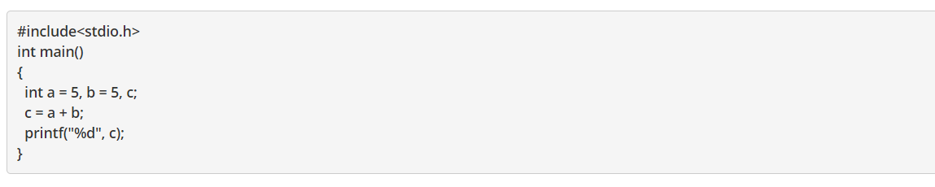
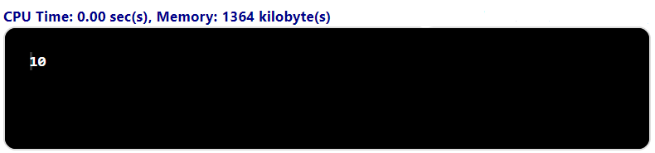
Example #1

Slide 36
Do not misunderstand space-complexity to be 1364 Kilobytes as shown in the output image.
The method to calculate the actual space complexity is shown below.
In the above program, 3 integer variables are used.
The size of the integer data type is 2 or 4 bytes which depends on the compiler.
Now, lets assume the size as 4 bytes.
So, the total space occupied by the above-given program is 4 * 3 = 12 bytes.
Since no additional variables are used, no extra space is required.

Slide 37
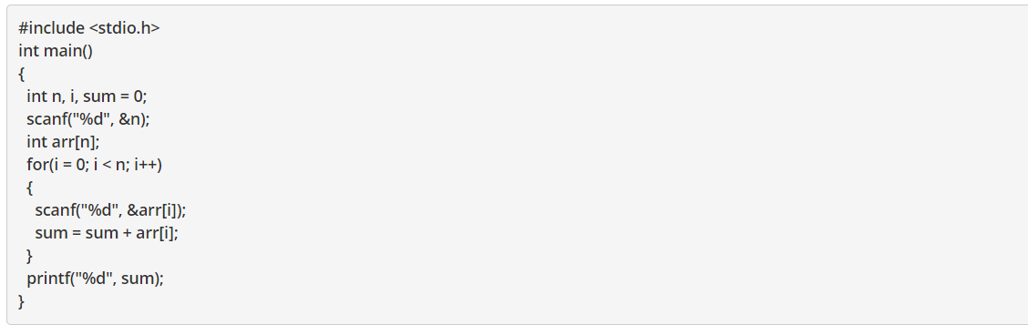

Slide 38
In the above-given code, the array consists of n integer elements. So, the space occupied by the array is 4 * n.
Also we have integer variables such as n, i and sum.
Assuming 4 bytes for each variable, the total space occupied by the program is 4n + 12 bytes.
Since the highest order of n in the equation 4n + 12 is n, so the space complexity is O(n) or linear.

Slide 39
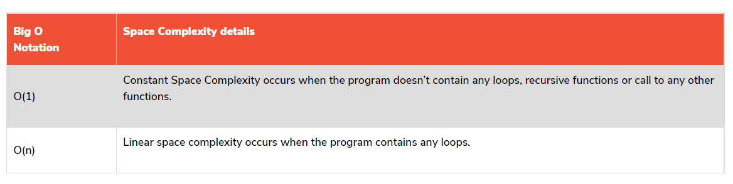

Slide 40
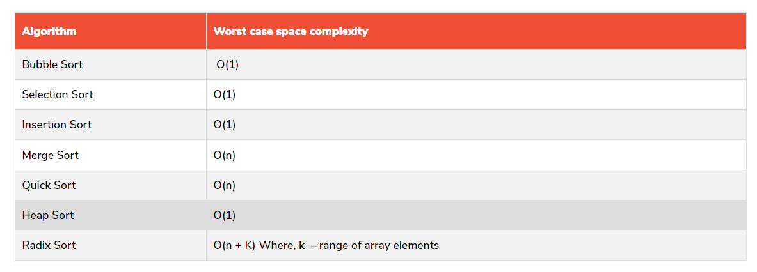

Slide 41
Kinds of analyses
Worst-case: (usually)
• T(n) = maximum time of algorithm on any input of size n.
Average-case: (sometimes)
• T(n) = expected time of algorithm over all inputs of size n.
• Need assumption of statistical distribution of inputs.
Best-case:
• Cheat with a slow algorithm that works fast on some input.

